Slide 1
Secure Data Hiding in Image Using Steganography
CAPSTONE PROJECT
Presented By:-
Student Name : Fareesa Hibah
College Name & Department : Vasavi College of Engineering Mechanical Department

Slide 2
OUTLINE
Problem Statement
Technology used
Wow factor
End users
Result
Conclusion
Git-hub Link
Future scope

Slide 3
Problem Statement
The project aims to create a tool that securely hides and retrieves secret messages within an image using steganography and encryption.
It involves encoding messages into an image file such that the visual quality of the image remains unchanged.
Only authorized users with the correct passcode can decrypt and read the hidden message.
This method enhances secure communication by ensuring that sensitive information is concealed and protected from unauthorized access.

Slide 4
Technology used
Python: The programming language used to write the code.
OpenCV: A library for image processing.
Steganography: The technique used to hide secret messages within images.
Cryptography: In the form of password protection for access control.

Slide 5
Wow factors
Hidden Communication: The ability to conceal a message inside an ordinary image without altering
its appearance significantly.
Access Control: The use of a passcode to ensure that only authorized individuals can decode and access
the hidden message.
Simple Implementation: Demonstrates complex cybersecurity concepts through easily understandable
code.

Slide 6
End users
Students and educators: For learning and teaching about cybersecurity concepts.
Privacy enthusiasts: Who are interested in secure communication methods.
Tech hobbyists: Looking to explore and experiment with steganography and encryption.

Slide 7
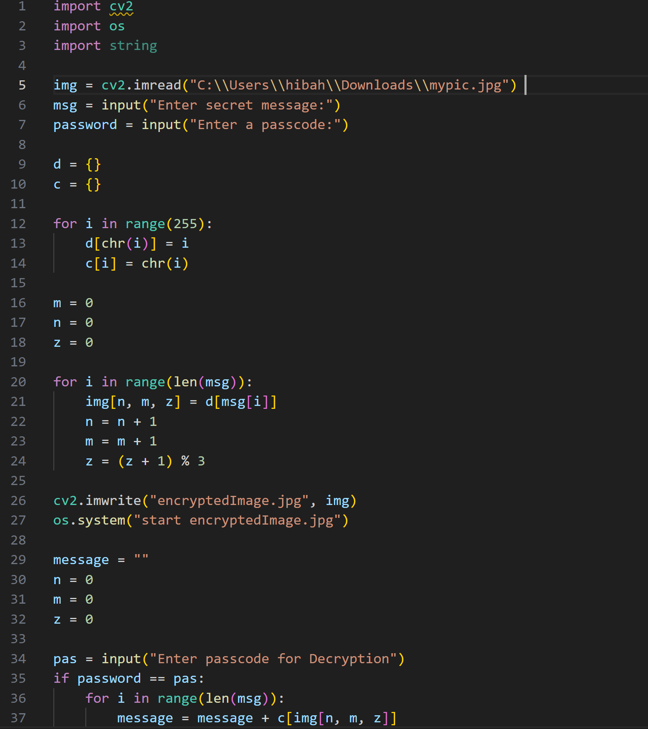
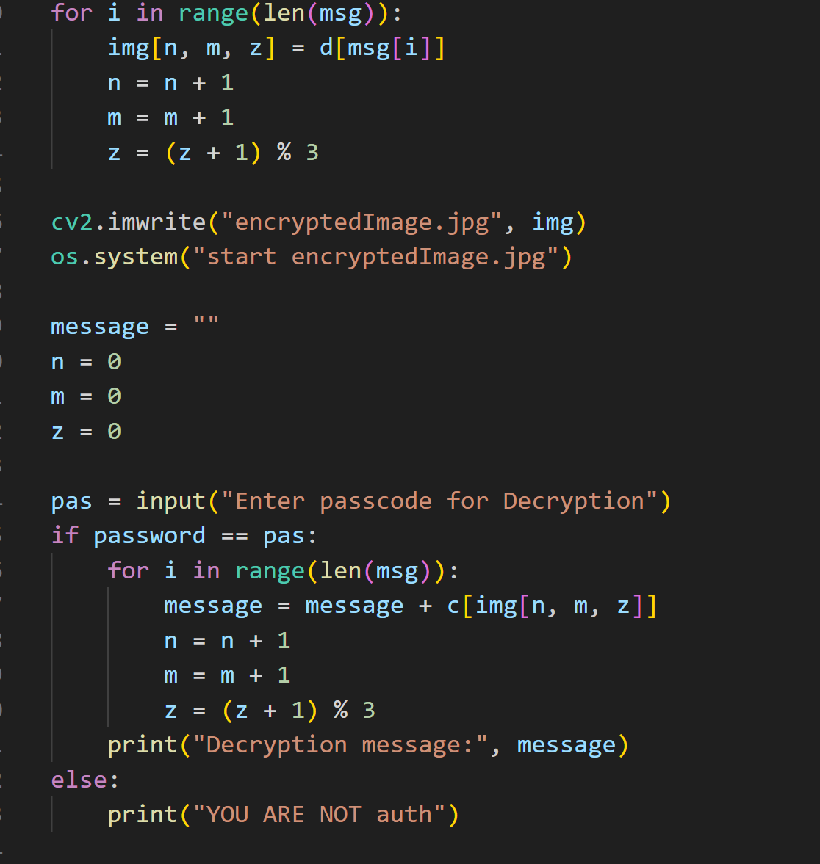
Code

Slide 8
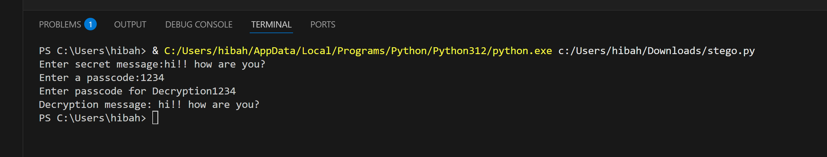
Output

Slide 9
Conclusion
This project serves as a practical introduction to steganography and encryption, showcasing how hidden messages can be securely encoded within images. By continuing to develop and expand on this concept, it can provide a deeper understanding of cybersecurity techniques and their real-world applications.

Slide 10
GitHub Link
Make sure that there should be readme file

Slide 11
Future scope(optional)
Enhanced Encryption: Integrate more sophisticated encryption algorithms for better security.
User Interface: Develop a user-friendly interface to make the tool accessible to a wider audience.
Robustness: Improve the algorithm to handle larger messages and various image formats.
Real-World Applications: Explore potential uses in secure communication, watermarking,
and digital rights management.

Slide 12
THANK YOU

